Slide 1
Redesigning Social Media Data Visualization
Improving Clarity, Reducing Clutter, and Enhancing Storytelling Juan Barrera

Slide 2
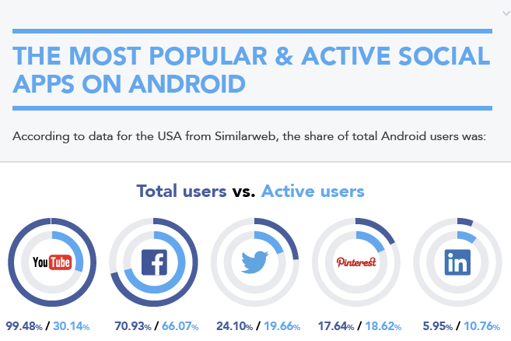
Charts within charts (Original Visualization)

Slide 3
Problems in the Original Visualization
1. Overuse of colors and circular gauges made comparisons difficult.
2. Cluttered labeling with redundant numbers.
3. Inefficient chart type (circular gauges) hindered comparison.

Slide 4
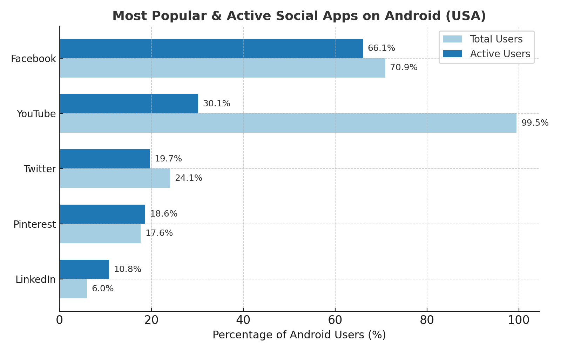
Redesigned Visualization

Slide 5
Improvements in the New Design
• Replaced circular gauges with horizontal bar chart.
• Simplified to two colors (Total vs. Active users).
• Sorted by Active Users to highlight engagement.
• Clear percentage labels directly on bars.
• Enhanced readability with spacing and cleaner layout.

Slide 6
Enhanced Understanding & Storytelling
• The redesigned chart makes it easy to see which apps truly engage users.
• Highlights contrasts (e.g., YouTube vs. Facebook).
• Storytelling shifts from 'downloads' to 'engagement'.
• Helps audience grasp insights at a glance.

Slide 7
Lessons Learned About Reducing Clutter
• Too many colors and shapes distract from the message.
• Simple chart types often communicate best.
• Labels should be direct and not redundant.
• Reducing clutter improves storytelling and focus.

